Slide 1

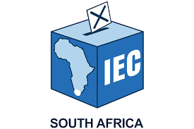

RESEARCH REPORT Regulating Political Finance in South Africa Perspectives on the Political Funding Act and Its Implementation
Electoral Commission of South Africa (IEC) and the Human Sciences Research Council (HSRC)
2025
Dr Ben Roberts, Dr Ngqapheli Mchunu, Dr Ntombizodumo Mkwanazi and Adv. Gary Pienaar
On behalf of the HSRC Developmental, Capable
and Ethical State (DCES) Research team
Presentation to IEC Symposium
^{18 June 2025}

Slide 2

Presentation outline
Study objectives
Methodology
[Literature review findings not included for reasons of space]
Quantitative study: SASAS results
Qualitative study: Key informant interviews
Policy considerations and recommendations

Slide 3
Study objectives
Evaluate the effectiveness of IEC capacity in implementing the Political Funding Act
Assess public and expert opinion on the thresholds and limits for private donations
Explore attitudes towards the Multi-Party Democracy Fund and strategies for its enhancement
Examine the possible relationship between political finance and gender equality in representation
Investigate the feasibility and desirability of different regulatory approaches (e.g., income-based vs. expenditure-based)
Consider whether responsibility for investigating breaches of the Act should remain with the IEC or be transferred to another institution
Identify the institutional and technical capacities required by the IEC to ensure full compliance with the Act

Slide 4



Methodology
Literature review
SASAS module
Qualitative KI interviews – 26 (political parties, Electoral Commission, civil society, academia, media and donors)
Gender focus throughout

Slide 5
SASAS module

Slide 6
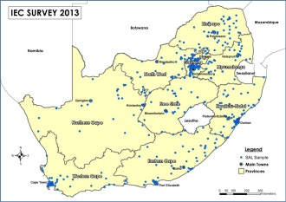
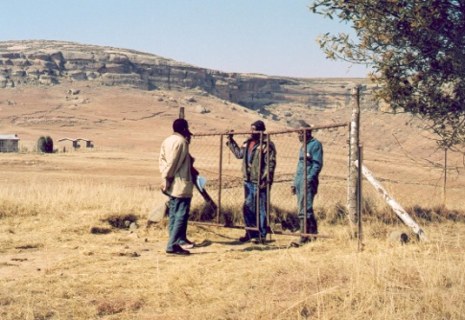
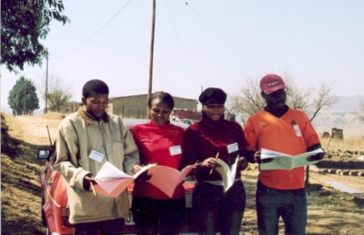
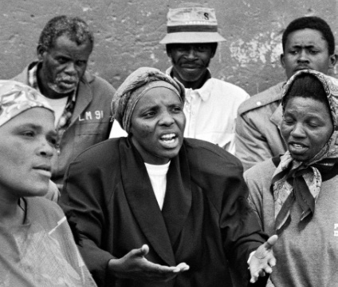
South African Social Attitudes Survey (SASAS) Methodology
Survey was conducted by the Human Sciences Research Council (HSRC)
Nationally representative of the population 16 years and older in private households across the 9 provinces
500 Small Area Layers (SALs) were selected using Census 2011 framework
3,500 addresses issued
Collected by face-to-face interview
Data collection: February-March 2025
Realised sample: 3,119 respondents
Data will be weighted using StatsSA’s latest mid-year population estimates once data quality control and cleaning completed

Slide 7




Attitudes to Political Funding

Slide 8
Dissatisfaction with the Political Climate
DEMOCRATIC FUNCTIONING
Public satisfaction and dissatisfaction with the way democracy is working in South Africa (%)
POLITICAL LEADERSHIP
Public satisfaction and dissatisfaction with the current political leaders in South Africa (%)
Source: HSRC SASAS 2024/25 IEC political funding module

Slide 9
Levels of Political Interest and Knowledge
Self-reported level of interest in politics for the general public (%)
Public responses to the question: “How often does politics seem so complicated that you cannot really understand what is going on?” (%)
Source: HSRC SASAS 2024/25 IEC political funding module

Slide 10
Patterns of Political Donation Behaviour
Public responses to the question: “Have you previously donated money to or raised funds for a political party or an independent candidate?” (%)
Socio-economic status and education were not strong predictors of donation behaviour.
Electoral participation was weakly linked to donation behaviour, with voters slightly more inclined to contribute.
Living in an urban area doubled the odds of having made political donations.
Being a member of a political party was associated with having made donations in the past.
Source: HSRC SASAS 2024/25 IEC political funding module

Slide 11
Support for the Freedom to Donate
Public agreement and disagreement with the statement: “You should have the freedom to donate money to political parties and independent candidates.”
Strong regional variations could be observed with higher levels of agreement in KwaZulu-Natal and lower levels in the Free State.
Electoral participation appeared to shape attitudes: regular voters were more likely to support the freedom to donate than sporadic voters or non-voters.
Prior donation behaviour did not significantly influence attitudes here.
Source: HSRC SASAS 2024/25 IEC political funding module

Slide 12




Public Backing for the Regulation of Political Funding

Slide 13
Awareness of South Africa’s Political Funding Act
Public responses to the question: “How much have you heard or read about the Political Funding Act?” (%)
Awareness is strongly linked to education and socio-economic status with more educated and affluent individuals more aware.
Those who have donated to political parties were more likely to be aware.
While political party members had higher levels of awareness, the difference in awareness between active and inactive members was minimal.
Source: HSRC SASAS 2024/25 IEC political funding module

Slide 14
Support for Political Finance Regulations
Public responses to the question: “To what extent do you support or oppose laws like the Political Funding Act that require all political parties and independent candidates to say where their funding comes from?” (%)
Support for the PFA was higher among those with post-secondary education.
Support strongest in the Eastern Cape and KwaZulu-Natal and the weakest in Northern Cape and Free State.
Past political donation behaviour did not significantly influence support for financial regulation. Those non-participants who intended to donate in the future were more likely to support the PFA.
Source: HSRC SASAS 2024/25 IEC political funding module

Slide 15
Anxiety over Elite Influence in South African Politics
Public responses to the question: “Overall, how worried are you that the decisions and actions of political parties and independent candidates in South Africa are being influenced by donations from the rich and powerful?” (%)
Higher levels of education and socio-economic status were associated with greater concern about possible elite influence.
Being a regular voter was also related to worry about elite manipulation.
Levels of worry about elite manipulation were highest in the Free State and KwaZulu-Natal. Levels of worry were lowest in the Eastern Cape, Limpopo and Northern Cape.
Source: HSRC SASAS 2024/25 IEC political funding module

Slide 16
Perceptions of Transparency in Political Donations
Public responses to the question: “Do you think the general public has too little or too much information about who donates money to political parties and independent candidates in South Africa?”
Concern about the level of public information was highest amongst those with a post-secondary education.
Concern about the level of transparency was linked to awareness of the PFA; the more aware, the more concerned about the level of information.
Those who perceived a lack of public information were more likely to support regulatory measures like PFA.
Source: HSRC SASAS 2024/25 IEC political funding module

Slide 17
Support for Donation Maximum Limit
Percentage of the population who think the donation maximum limit of R15 million was too low, too high or about right
Compared to the poor, those with higher socio-economic status were more likely to favour stricter donation limits.
Support for stricter donation limits was highest in provinces like Gauteng and the Free State.
Support for laws like the PFA correlated with perceptions of the donation cap; those backing such laws were less likely to view the limit as too high.
Source: HSRC SASAS 2024/25 IEC political funding module

Slide 18
Perceptions of Donation Threshold
Percentage of the population who think the threshold that political parties and independent candidates must report donations of R100,000 was too low, too high or about right
Residents in the Free State and the Northern Cape were more likely to view the threshold as inadequate.
Awareness of the PFA also influenced opinions about the threshold limit; those familiar with the law were more likely to consider the threshold too high.
Those who opposed financial regulation laws tended to view the threshold as too high.
Source: HSRC SASAS 2024/25 IEC political funding module

Slide 19




Public Attitudes towards the Role of the Electoral Commission

Slide 20
Support for Electoral Commission Oversight
Public responses to the question: “In your opinion, who should be primarily responsible for collecting information about where political parties and independent candidates in South Africa get their funding?” (%)
Formal schooling positively correlated with a partiality for the Commission’s role.
We found that a preference for the Commission was stronger among those who participated in elections.
Active political party members were more likely to favour the Commission in this role.
Preference for the Commission was highest in KwaZulu-Natal and Mpumalanga.
Source: HSRC SASAS 2024/25 IEC political funding module

Slide 21
Views on Importance of Tracking Political Spending
Public responses to the question: “How important is it for the Electoral Commission to collect information on how much money political parties and independent candidates in South Africa are spending?” (%)
Past donors to political parties or independent candidates were less likely to think this was an important task.
Support for laws like the PFA correlated with the perceived importance of tracking political spending.
Adults who felt that the public lacked sufficient information on political donations were more likely to prioritise the Commission's role in gathering such data.
Source: HSRC SASAS 2024/25 IEC political funding module

Slide 22
Importance of Tracking Political Funding Sources
Public responses to the question: “Overall, how important is it for the Electoral Commission to collect information about where political parties and independent candidates in South Africa get their funding from?” (%)
Those who value identifying funding sources tend to think that monitoring spending was important.
Those who believe there is a deficiency in funding information available to the public are more likely to think that this task is important.
People who were concerned about wealthy donors influencing politics are more likely to consider this task to be essential.
Source: HSRC SASAS 2024/25 IEC political funding module

Slide 23
Confidence in Tracking Political Funding Sources
Public responses to the question: “How confident are you that the Electoral Commission has been able to collect accurate information about where political parties and independent candidates in South Africa get their funding from?” (%)
Responses differed by educational attainment; better-educated persons are more likely to be confident.
Confidence was highest in Mpumalanga and lowest in the Eastern Cape as well as KwaZulu-Natal.
People who value funding transparency were more likely to trust the Electoral Commission’s ability to collect this information.
Source: HSRC SASAS 2024/25 IEC political funding module

Slide 24
Confidence in the Ability to Enforce Political Funding Act
Public responses to the question: “How confident are you that the Electoral Commission is able to take action against political parties and independent candidates who do not comply with the Political Funding Act or fail to provide accurate information on their funding?” (%)
Those who were confident in the Commission's ability to gather political funding information also tended to also have confidence in its ability to enforce compliance.
Individuals who believed in the freedom to donate to political parties showed higher confidence in the Commission’s enforcement role.
Confidence was highest in the Western Cape.
Source: HSRC SASAS 2024/25 IEC political funding module

Slide 25





Attitudes towards the Multi-Party Democracy Fund

Slide 26
Awareness of the Multi-Party Democracy Fund
Public responses to the question: “How much have you heard or read about the Multi-Party Democracy Fund?” (%)
Awareness levels varied by province of residence; it was lowest in Limpopo and Mpumalanga.
Awareness differed by gender and population group; it was lower for women and the Black African majority.
Awareness of the MPDF is positively correlated with awareness of the PFA; people who were more aware of the former were discovered to be more aware of the latter.
Source: HSRC SASAS 2024/25 IEC political funding module

Slide 27
Confidence in the Electoral Commission’s Management
Public responses to the question: “How confident are you that the Electoral Commission manages the Multi-Party Democracy Fund (MPDF) fairly and effectively? ” (%)
Higher education and socio-economic status correlated with greater trust in the Commission.
Provinces like Limpopo and the North West were discovered to have relatively low levels of confidence.
Awareness of the MPDF also plays a role, as those more informed about the Fund tend to have higher confidence in its management.
Source: HSRC SASAS 2024/25 IEC political funding module

Slide 28
Willingness to Donate to the Multi-Party Democracy Fund
Public responses to the question: “How willing would you be to donate to the Multi-Party Democracy Fund?” (%)
Adults who had never voted were less willing to donate to the MPDF than the national average.
Those who have previously donated to a party or candidate were found to be more likely to contribute to the MPDF.
Distrust in the fund’s management played a role in shaping willingness to donate. Persons with low confidence were less willing.
Source: HSRC SASAS 2024/25 IEC political funding module

Slide 29
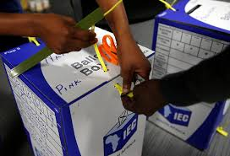
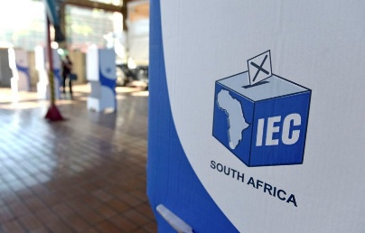
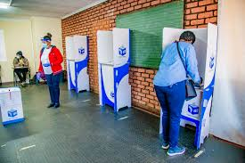
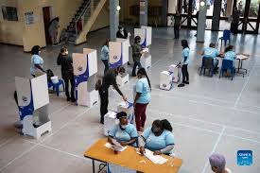
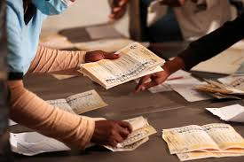
Self-reported reasons for Multi-Party Democracy Fund donation intentions
Fieldworkers asked survey participants an open-ended question about why they were willing or unwilling to donate to the MPDF.
RELUCTANT TO DONATE: Many adults expressed reluctance to donate due to a lack of awareness, distrust in political processes, and concerns about the misuse of funds.
Financial constraints also play a significant role; some of the mass public felt unable to contribute beyond their basic needs.
PRO-DONATION: Those willing to donate see it as a civic duty to strengthen democracy, promote transparency and empower marginalised groups (particularly women).
These findings reaffirm the need for improved public education and outreach to address scepticism and foster broader support for the MPDF as a tool for political accountability and social change.

Slide 30
Will Tax Rebates Boost Willingness to Donate?
Public responses to the question: “Would you be more or less willing to donate to the Multi-Party Democracy Fund if you received some money back on the taxes you pay (i.e., tax rebate)?“ (%)
We discovered that men, younger adults, and people living in the Western Cape showed higher willingness to donate under these conditions.
More educated, white adults as well as residents of the Eastern Cape, the Northern Cape and the North West showed less willingness.
Active political party members and past donors were more likely to respond positively to the rebate offer.
Source: HSRC SASAS 2024/25 IEC political funding module

Slide 31




Changes to the Political Financial Regulatory Framework

Slide 32
Support for Monitoring Party Spending
Public agreement and disagreement with the statement: “Monitoring how much a political party is spending is a good way to check how accurately it is reporting the donations it has received”
Higher socio-economic status and education levels correlated with stronger agreement.
Certain provinces (i.e., the Northern Cape and Limpopo) expressed lower levels of agreement.
Voters are more likely to agree than those who have not voted in elections before.
Past donors expressed scepticism about this option.
Source: HSRC SASAS 2024/25 IEC political funding module

Slide 33
Promoting Female Political Representatives
Public agreement and disagreement with the statement: “One of the conditions of a political party receiving public money should be that it promotes and supports female representatives (e.g., on its party lists and in leadership roles).”
Agreement with the statement was found to be highest in KwaZulu-Natal and weakest in in the Free State and the Western Cape.
More educated individuals showed greater agreement with the statement.
Voters and politically active individuals were more likely to endorse this provision.
Women not a lot more likely to agree than men.
Source: HSRC SASAS 2024/25 IEC political funding module

Slide 34
Additional issues for discussion
arising from key informant interviews (KIIs)

Slide 35
Key informant interviews (KIIs): IEC effectiveness in implementation of the PFA
Most respondents believe that, overall, the IEC is effectively implementing the PFA but acknowledged its strengths and weaknesses.
For instance, respondents noted that the PFU’s administrative arm is considered reasonably capacitated, but the investigation function is not adequately capacitated.
Several limitations hamper the IEC's effectiveness, including legal provisions enabling effective co-ordination with other institutions such as the Auditor-General, investigative capacity, technical difficulties with the online disclosure platform, and communication effectiveness affecting donors and public understanding of the IEC’s mandates.

Slide 36
Issues relating to political funding that jeopardise the core role of the Commission
Most respondents believe the IEC should retain overall responsibility for implementing the PFA, but there are arguments for considering alternative or complementary institutions.
There is broad support for collaboration with other institutions to address the IEC's capacity constraints and enhance investigative effectiveness. Political funding regulation or some of its elements such as investigation and enforcement might be better managed by other partners.
A significant argument by some respondents suggests that the IEC’s dual mandate (administering elections and enforcing the PFA) creates inherent conflicts by compromising the IEC's primary electoral mandate.
Any sign of perceived favouritism or not ‘noticing’ glaring financial discrepancies could be viewed as being partial.
Perceptions regarding the IEC’s impartiality differed, with some political parties expressing scepticism, while civil society and donor respondents strongly affirmed the IEC’s neutrality.
The IEC’s ability to maintain its credibility and impartiality depends largely on its ability to navigate complexities, potentially supported by public education and adequate resources.

Slide 37
Monitoring income and/or expenditure
The two approaches focus on different regulatory goals:
(a) Tracking income prioritises transparency about contestants, which empowers voters and prevents undue foreign or domestic influence.
(b) Tracking or regulating expenditure promotes a level playing field and avoids wealthy parties buying influence through massive campaigns.
South Africa’s current income-based system provides a foundation for political funding transparency, but its limitations, such as undisclosed income and the risk of circumvention, suggest that an expenditure-based or hybrid model may have merit and may enhance accountability.
While the Commission should take appropriate note of large expenditures incurred in plain sight that don’t neatly correlate with donations disclosed, the timing of the disclosures, the time taken for investigations and the prosecutorial and judicial processes make the finalisation of such matters a source of frustration and criticism of the Commission.

Slide 38
Further engagement around key questions

Slide 39
Key issues
The focus of political funding regulation revolves around (a) regulating political organisational income and (b) regulating campaign expenditure, with different requirements for monitoring, investigation and enforcement of each.
The necessary and appropriate capacity for the enforcement of (a) regulating political organisational income; and (b) regulating campaign expenditure.
Tracking income prioritises transparency about contestants, which empowers voters and prevents undue foreign or domestic influence (also relevant to issues of money laundering, tax evasion and foreign exchange).
Tracking or regulating expenditure promotes a level playing field and avoids wealthy parties buying influence through massive campaigns. It is also important to take account of how to ensure that incumbency is not abused to enable public funding to be used for party political campaigns, which relates to the work of the Auditor-General of South Africa.

Slide 40
Key questions
How to safeguard the IEC’s core mandate of election management?
While cooperation with other agencies to implement the legislation has been emphasised, what forms can this take without undermining the mandates of the various institutions and ensuring that proper safeguards in relation to privacy, among other issues, are in place; and would this require amendments of other legislation?
Does the MPDF provide opportunities to expand support for democracy that, in its current form, it is not set up to perform?

Slide 41
